Slide 2
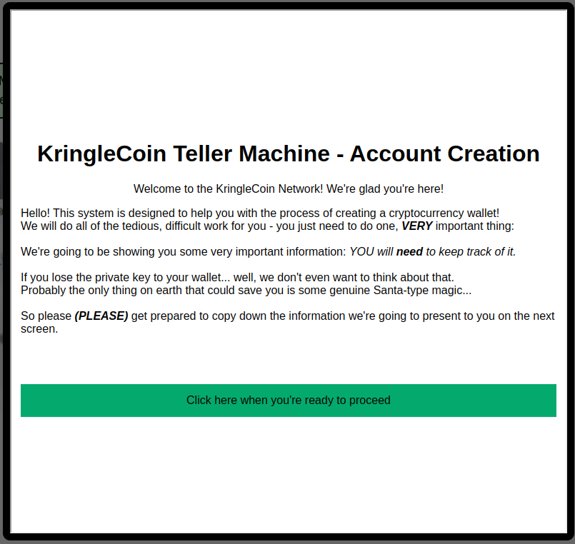

Slide 3
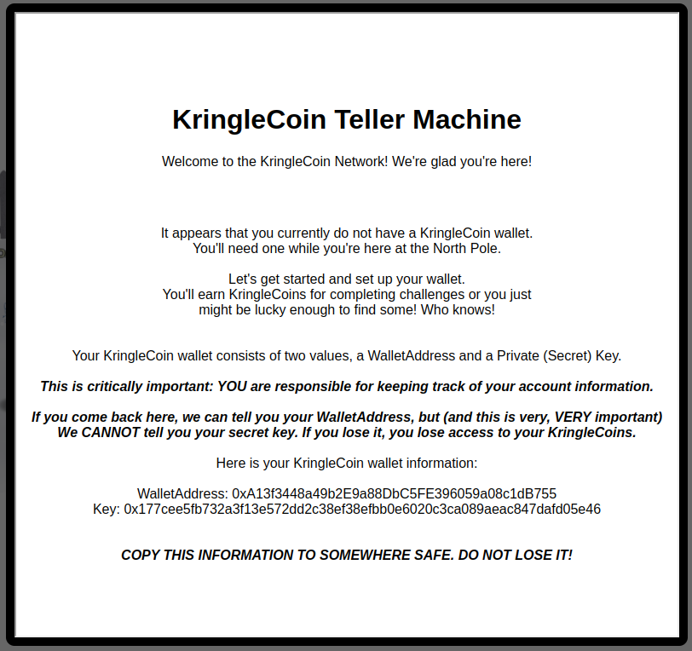

Slide 4
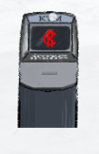
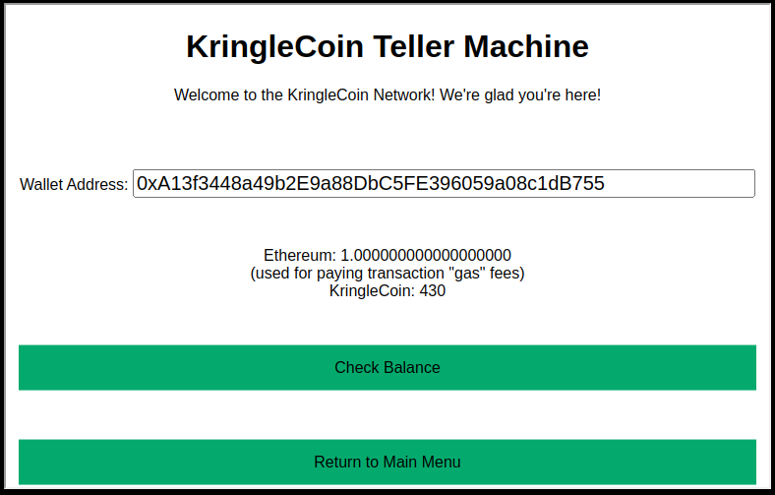
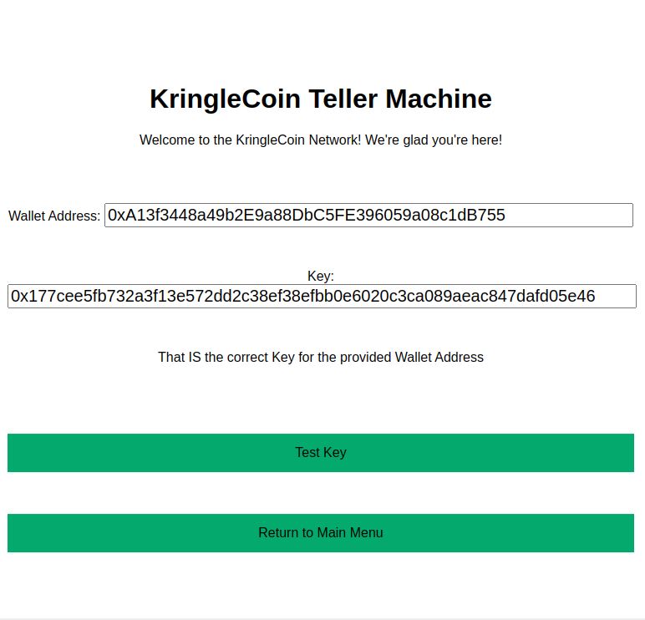
KringleCoin Teller Machine
Welcome to the KringleCoin Network! We're glad you're here!
It appears that you currently do not have a KringleCoin wallet.
You'll need one while you're here at the North Pole.
Let's get started and set up your wallet.
You'll earn KringleCoins for completing challenges or you just
might be lucky enough to find some! Who knows!
Your KringleCoin wallet consists of two values, a WalletAddress and a Private (Secret) Key.
This is critically important: YOU are responsible for keeping track of your account information.
If you come back here, we can tell you your WalletAddress, but (and this is very, VERY important)
We CANNOT tell you your secret key. If you lose it, you lose access to your KringleCoins.
Here is your KringleCoin wallet information:
WalletAddress: 0xA13f3448a49b2E9a88DbC5FE396059a08c1dB755
Key: 0x177cee5fb732a3f13e572dd2c38ef38efbb0e6020c3ca089aeac847dafd05e46
COPY THIS INFORMATION TO SOMEWHERE SAFE. DO NOT LOSE IT!

Slide 8
Wireshark practice
Http
App.php
687
192.185.57.242
Ref_Sept24-2020.zip
Israel, south sudan
yes

Slide 9
Eval the zip
Packet 687 – save data
$base64 -d data.txt > Ref_Sept24-2020.zip
Dridex malware
https://www.hybrid-analysis.com/sample/fad001d463e892e7844040cabdcfa8f8431c07e7ef1ffd76ffbd190f49d7693d

Slide 11
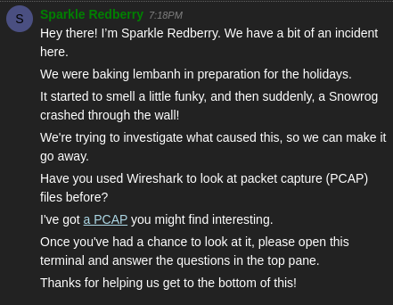
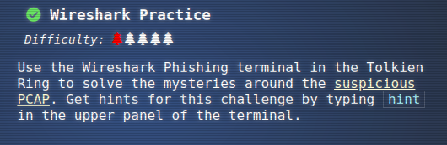
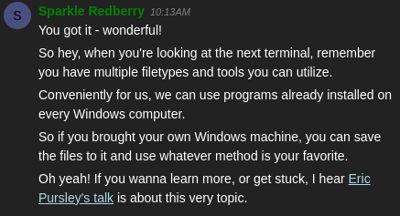

Slide 12
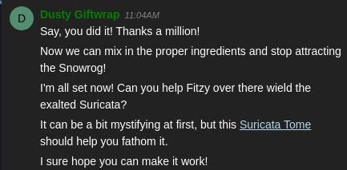
12/24/2022
recipe_updated.txt
Line 111507 – “$foo = Get-Content .\Recipe| % {$_ -replace 'honey', 'fish oil'}”
Line 112952 “$foo | Add-Content -Path 'Recipe'”
Recipe.txt
Yes
No – but it should be yes lin 114890 remove
Event id 4104
Yes
Honey (replaced w/fish oil)

Slide 13
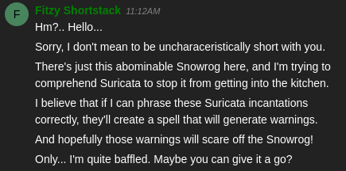
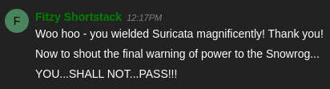

Slide 14
Suricata
alert dns any any -> any any (msg:"Known bad DNS lookup, possible Dridex infection"; dns.query; content:"adv.epostoday.uk"; nocase; sid:2221;)
alert http 192.185.57.242 any -> $HOME_NET any (msg:"Investigate suspicious connections, possible Dridex infection"; sid:2222;)
alert http $HOME_NET any -> 192.185.57.242 any (msg:"Investigate suspicious connections, possible Dridex infection"; sid:2223;)
alert tls any any -> any any (msg:"Investigate bad certificates, possible Dridex infection"; tls.subject:"CN=heardbellith.Icanwepeh.nagoya"; sid:2224;)
alert http any any -> any any (msg:"Suspicious JavaScript function, possible Dridex infection"; file_data; content:"let byteCharacters = atob"; sid:2225;)

Slide 16
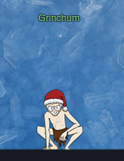
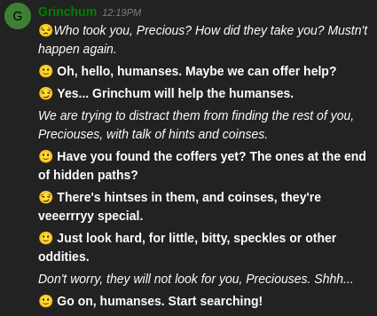

Slide 17
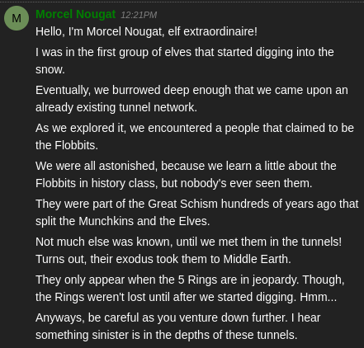

Slide 18
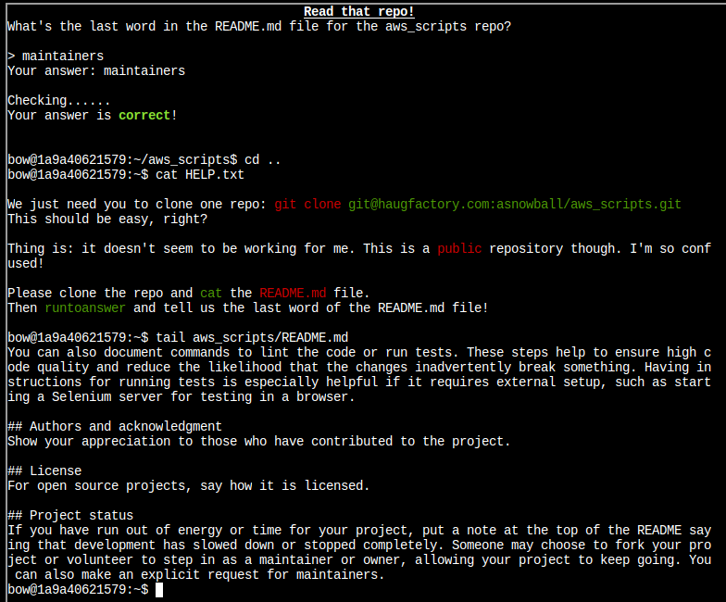
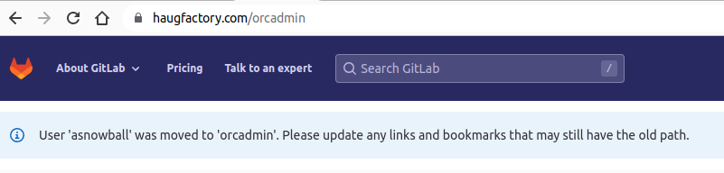
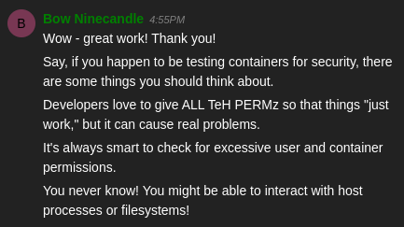

Slide 20
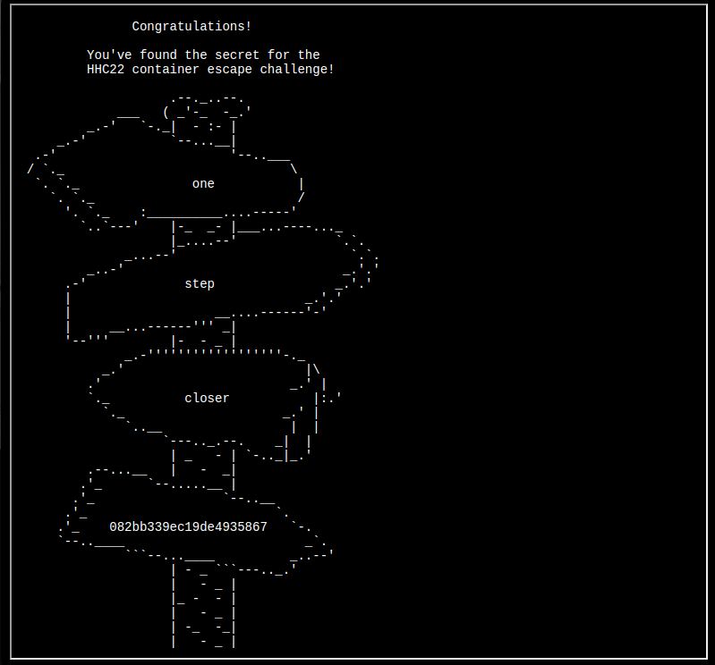
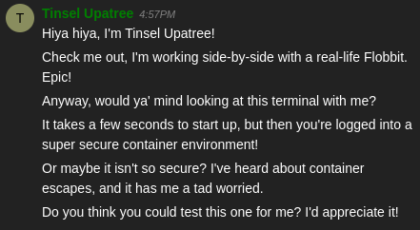

Slide 21
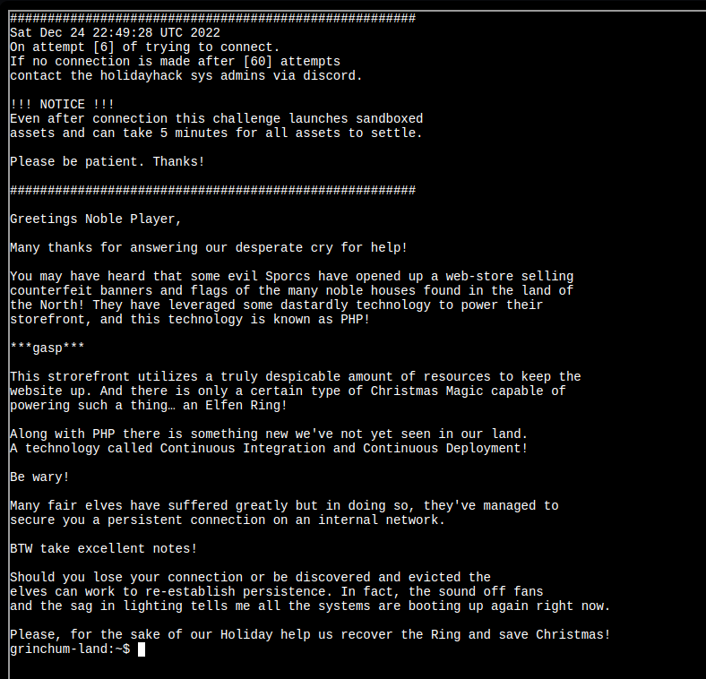
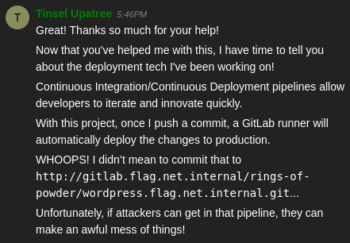
Text
082bb339ec19de4935867

Slide 22
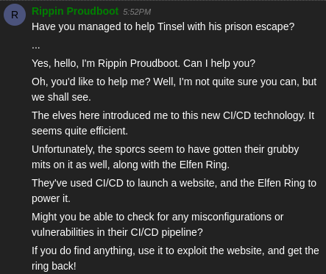
http://gitlab.flag.net.internal/rings-of-powder/wordpress.flag.net.internal.git

Slide 23
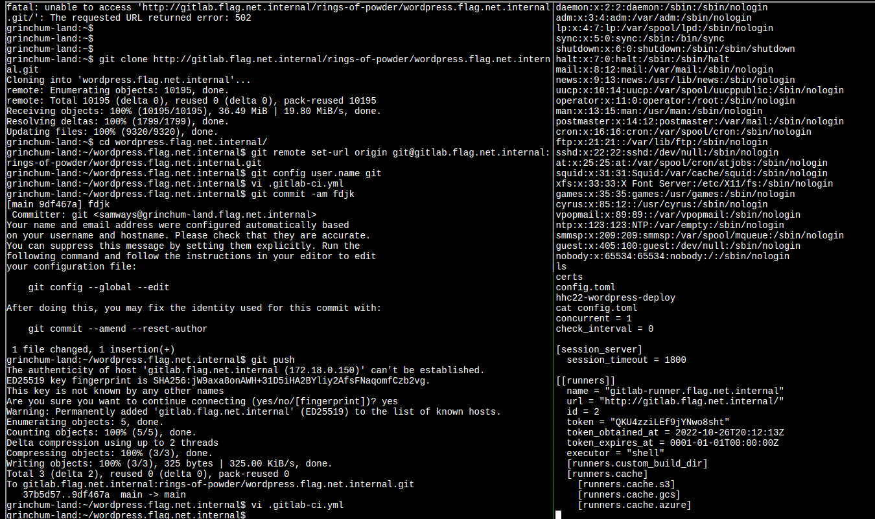

Slide 24
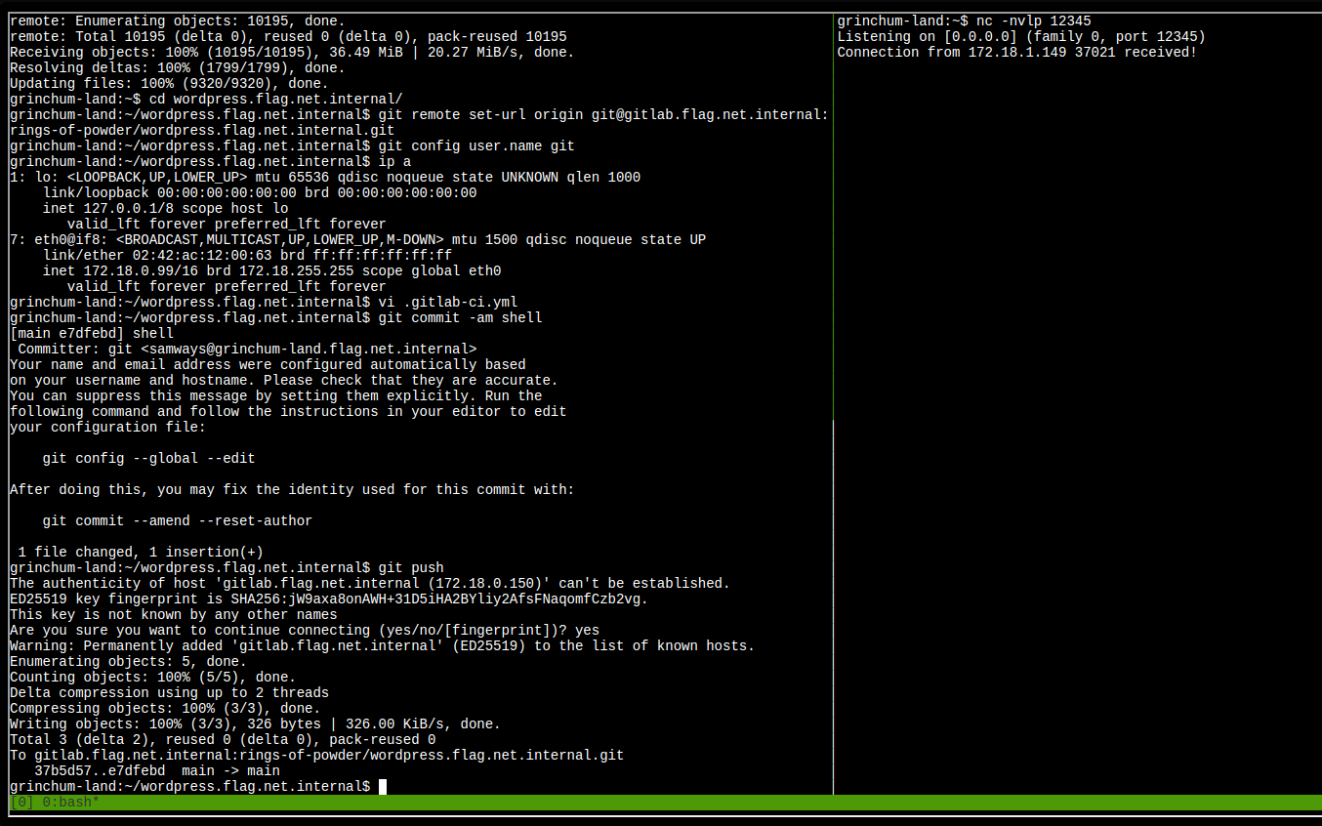
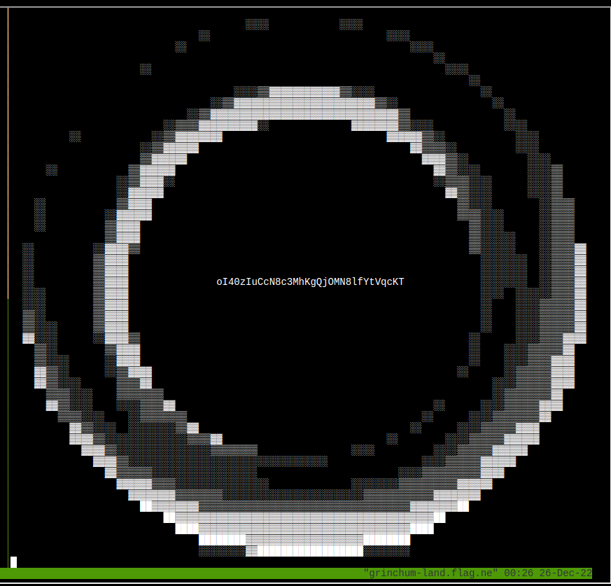
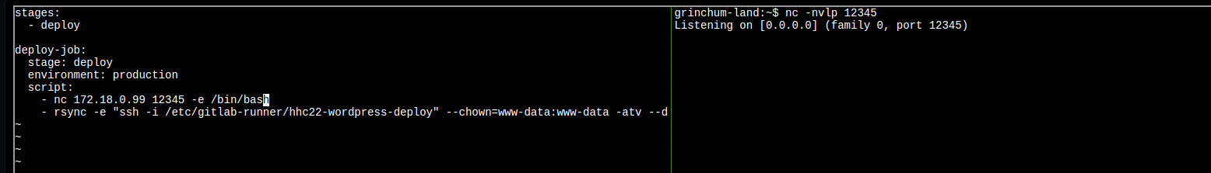
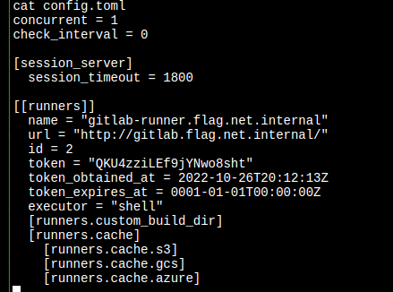
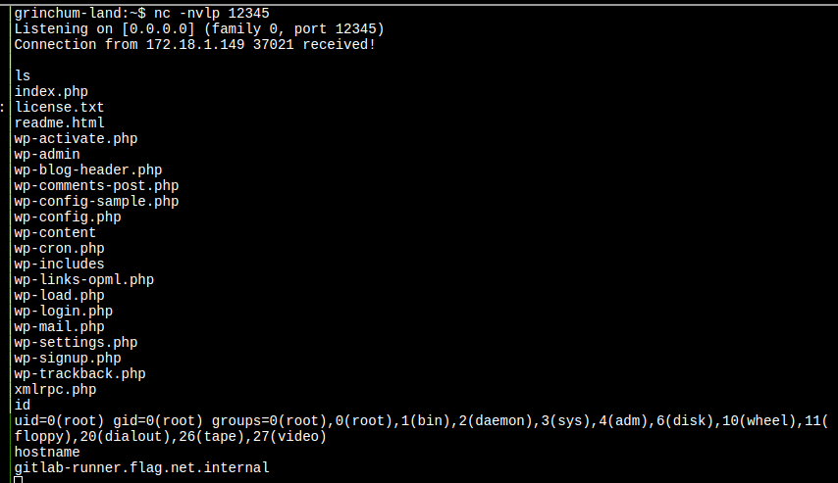

Slide 25
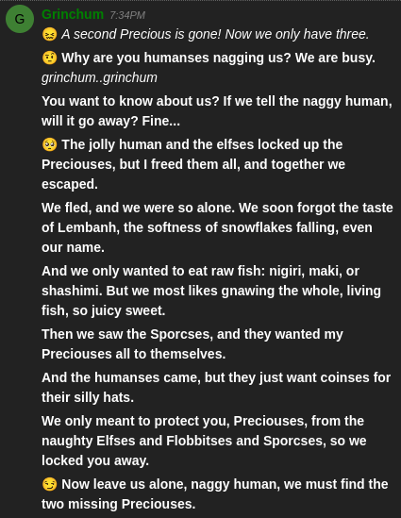
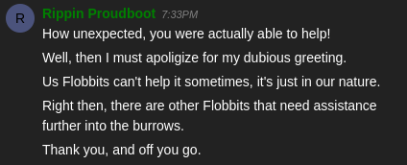

Slide 26
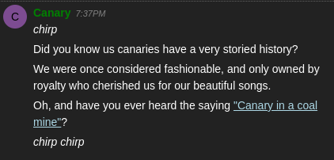
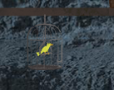
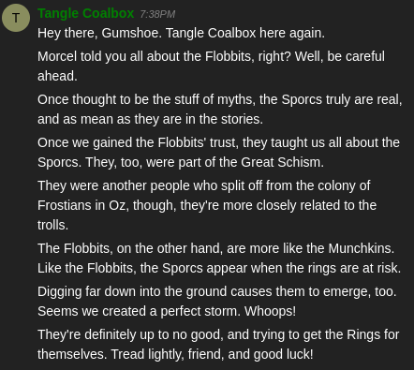

Slide 27
conversations

Slide 29
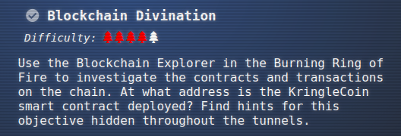
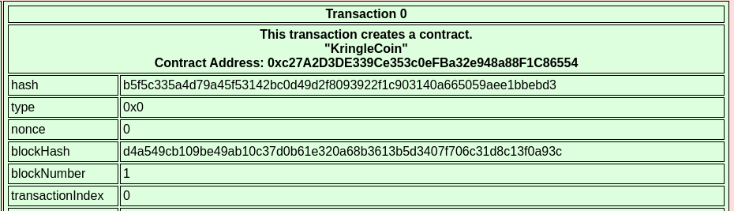
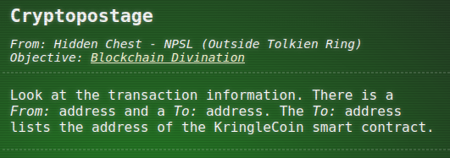
Block 1, find transaction 0
0xc27A2D3DE339Ce353c0eFBa32e948a88F1C86554

Slide 30
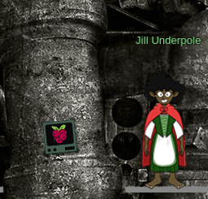
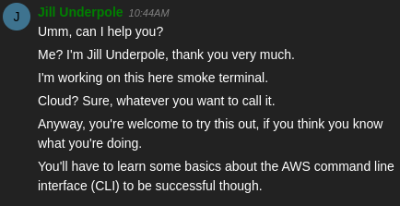
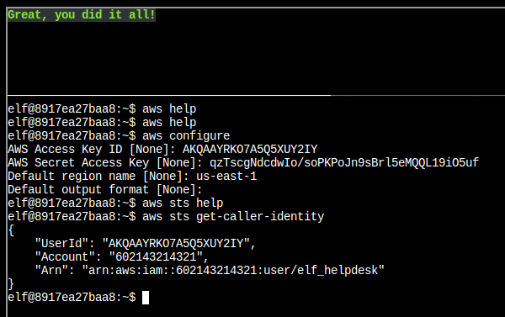
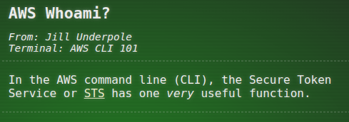
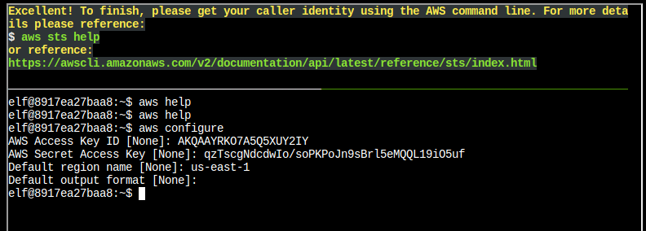

Slide 31
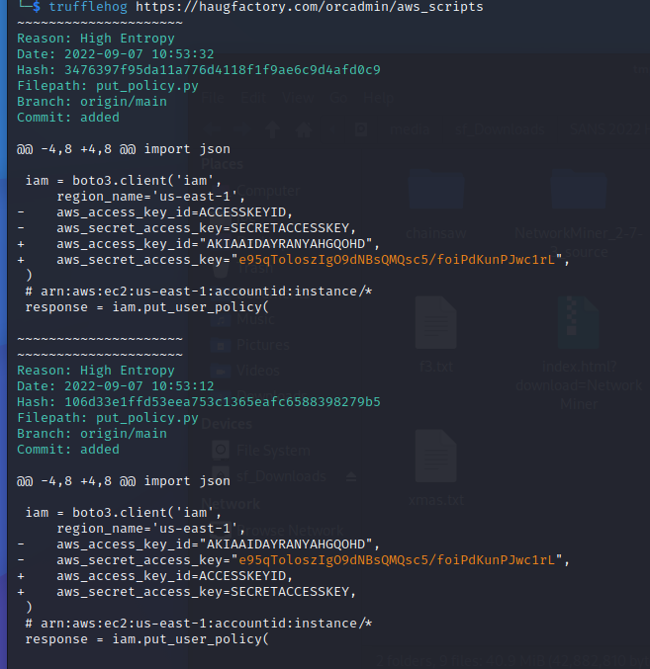
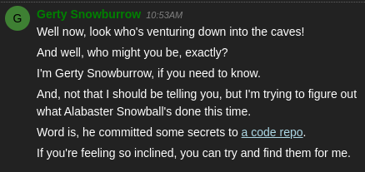
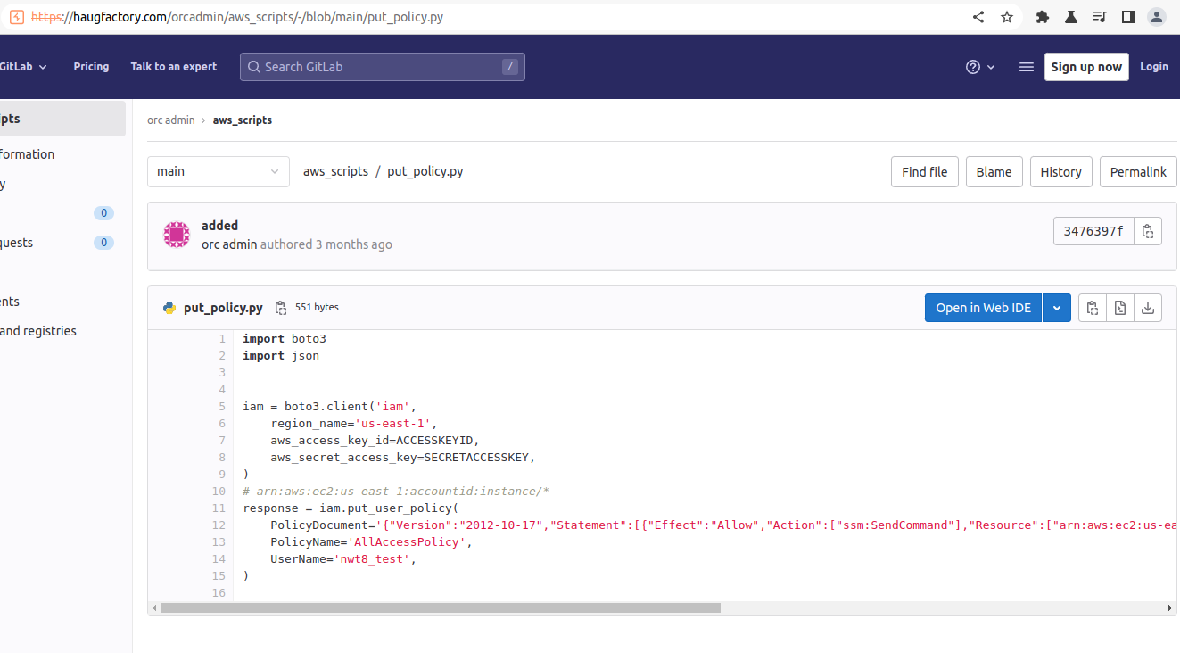
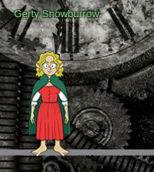

Slide 32
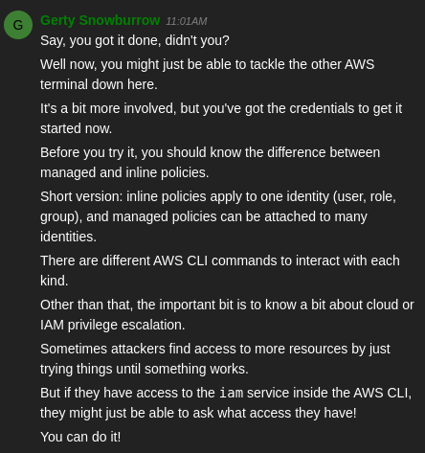
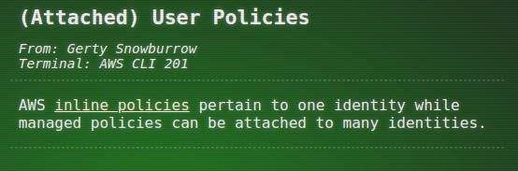
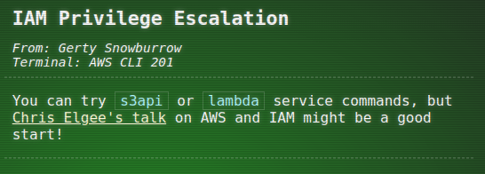
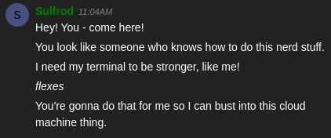

Slide 33
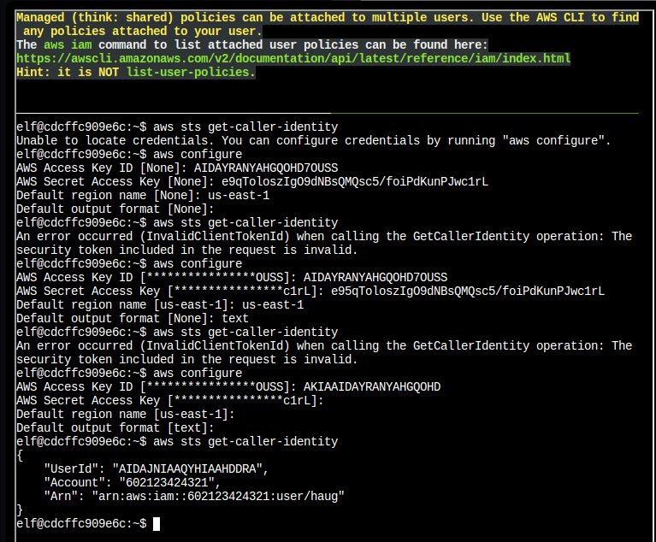






Slide 35





Slide 37
To discover the naughty IP, we select Statistics, Conversations, IPv4 tab and review traffic to our server (10.12.42.16).
Answer: 18.222.86.32

Slide 38


Slide 39


Slide 40

Filter ip.addr == 169.254.169.254

Slide 41



Slide 42


Slide 43


Slide 46
Review source for comment | https://www.w3docs.com/snippets/html/how-to-set-background-color-in-html.html
@&@&&W&&W&&&& | <body style="background-color:white"> | <script>document.body.style.backgroundColor = "blue";</script> | <<svg width="100%" height="100%">><<rect x="0" y="0" width=100% height="90" style="fill:white;" />> <<rect x="0" y="91" width=100% height="50" style="fill:blue;" />><</svg>>

Slide 47


Slide 48






Slide 51





Slide 52

To purchase this hat you must:
Use a KTM to pre-approve a 10 KC transaction to the wallet address: 0x5E5d991F67A94CeA0D54d82B361ef031fE94FD0e
Return to this kiosk and use Hat ID: 20 to complete your purchase.

Slide 53


Slide 54




Slide 56
Fountain
Santa
Kringle really likes the cookies here so I always make them the same way.
Kringle really dislikes it if anyone tries to TAMPER with the cookie recipe Glamtariel uses.
Candycane
Some that are silver may never shine
Some who wander may get lost
All that are curious will eventually find
What others have thrown away and tossed.
From water and cold new ice will form
Frozen spires from lakes will arise
Those shivering who weather the storm
Will learn from how the TRAFFIC FLIES
Ice
It's always great when old friends visit!
Hey, its Chilly Icycube, my old friend!
I remember when they were but a small drop in the Dimrofel.
Elf
I don't get away as much as I used to.
I think I have one last trip in me which I've probably put off for far too long.
The elves do a great job making PATHs which are easy to follow once you see them.

Slide 57
Glamtariel
Santa
I don't know why anyone would ever ask me to TAMPER with the cookie recipe.
I know just how Kringle likes them.
Glamtariel likes to keep Kringle happy so that he and the elves will visit often.
Candycane
Mmmmm, I love Kringlish Delight!
I think Glamtariel is thinking of a different story.
Ice
No worries, it doesn't get nearly as cold here as it did in Melgarexa. Brrrr, that was one frigid trip.^I think it's a perfect temperature here.
Elf
I helped the elves to create the PATH here to make sure that only those invited can find their way here.^I wish the elves visited more often.

Slide 58
 | Dropped On | Glamtariel | Fountain
Round 1
Santa(img2) | Princess | I don't know why anyone would ever ask me to TAMPER with the cookie recipe. I know just how Kringle likes them. | Glamtariel likes to keep Kringle happy so that he and the elves will visit often.
Candycane(img1) | Princess | Mmmmm, I love Kringlish Delight! | I think Glamtariel is thinking of a different story.
Ice Cube(img4) | Princess | No worries, it doesn't get nearly as cold here as it did in Melgarexa. Brrrr, that was one frigid trip. | I think it's a perfect temperature here.
Elf(img3) | Princess | I helped the elves to create the PATH here to make sure that only those invited can find their way here. | I wish the elves visited more often.
Santa(img2) | Fountain | Kringle really likes the cookies here so I always make them the same way. | Kringle really dislikes it if anyone tries to TAMPER with the cookie recipe Glamtariel uses.
Candycane(img1) | Fountain | I think fountain gets confused about things sometimes. | Zany Zonka makes the best of these!
Elf(img3) | Fountain | I don't get away as much as I used to. I think I have one last trip in me which I've probably put off for far too long. | The elves do a great job making PATHs which are easy to follow once you see them.
Ice Cube(img4) | Fountain | It's always great when old friends visit! | Hey, its Chilly Icycube, my old friend! I remember when they were but a small drop in the Dimrofel.
Round 2
Green Ring (img2) | Princess | I do have a small ring collection, including one of these. | I think Glamtariel likes rings a little more than she lets on sometimes.
Igloo(img1) | Princess | It's understandable to wonder about home when one is adventuring. | I think I'd worry too much if I ever left this place.
Star(img3) | Princess | O Frostybreath Kelthonial,\nshiny stars grace the night\nfrom heavens on high! | Up and far many look\naway from glaciers cold,\nTo Phenhelos they sing\nhere in Kringle's realm!
Ice Boat (img4) | Princess | These ice boat things would have been helpful back in the day. I still remember when Boregoth stole the Milsarils, very sad times | k in the day. I still remember when Boregoth stole the Milsarils, very sad times.^I'm glad I wasn't around for any of the early age scuffles. I shudder just thinking about the stories.
Green Ring (img2) | Fountain | Careful with the fountain! I know what you were wondering about there. It's no cause for concern. The PATH here is closed! | Between Glamtariel and Kringle, many who have tried to find the PATH here uninvited have ended up very disAPPointed. Please click away that ominous eye!
Igloo(img1) | Fountain | The fountain shows many things, some more helpful than others. It can definitely be a poor guide for decisions sometimes. | What's this? Fake tickets to get in here? Snacks that don't taste right? How could that be?
Star(img3) | Fountain | O Frostybreath Kelthonial,\nshiny stars grace the night\nfrom heavens on high! | Up and far many look\naway from glaciers cold,\nTo Phenhelos they sing\nhere in Kringle's realm!
Ice Boat (img4) | Fountain | Did you know that I speak in many TYPEs of languages? For simplicity, I usually only communicate with this one though. | I pretty much stick to just one TYPE of language, it's a lot easier to share things that way.
Round 3
Blue Ring (img2) | Princess | I love these fancy blue rings! You can see I have two of them. Not magical or anything, just really pretty. | If asked, Glamtariel definitely tries to insist that the blue ones are her favorites. I'm not so sure though.
Silver Ring (img1) | Princess | Wow!, what a beautiful silver ring! I don't have one of these. I keep a list of all my rings in my RINGLIST file. Wait a minute! Uh, promise me you won't tell anyone. | I never heard Glamtariel mention a RINGLIST file before. If only there were a way to get a peek at that.
Red Ring (img4) | Princess | Ah, the fiery red ring! I'm definitely proud to have one of them in my collection. | I think Glamtariel might like the red ring just as much as the blue ones, perhaps even a little more.
Blue Ring (img3) | Princess | I love these fancy blue rings! You can see I have two of them. Not magical or anything, just really pretty. | If asked, Glamtariel definitely tries to insist that the blue ones are her favorites. I'm not so sure though.
Blue Ring (img2) | Fountain | I like to keep track of all my rings using a SIMPLE FORMAT, although I usually don't like to discuss such things. | Glamtariel can be pretty tight lipped about some things.
Silver Ring (img1) | Fountain | You know what one of my favorite songs is? Silver rings, silver rings .... | Glamtariel may not have one of these silver rings in her collection, but I've overheard her talk about how much she'd like one someday.
Red Ring (img4) | Fountain | Hmmm, you seem awfully interested in these rings. Are you looking for something? I know I've heard through the ice cracks that Kringle is missing a special one. | You know, I've heard Glamtariel talk in her sleep about rings using a different TYPE of language. She may be more responsive about them if you ask differently.
Blue Ring (img3) | Fountain | I like to keep track of all my rings using a SIMPLE FORMAT, although I usually don't like to discuss such things. | Glamtariel can be pretty tight lipped about some things.

Slide 59


Slide 61
Backgrounds
We can see chest locations site images/backgrounds in the underground_main.jpg
And shout out to those looking at the site graphics :)

Slide 62

Chest 1 hall of talks

Slide 63

Chest 2

Slide 64

Chest 3

Slide 65


Chest 4

Slide 66


Slide 67


Slide 71


Slide 73


Slide 74


Slide 75


Slide 76


Slide 77
mt_user@b8f89a7dbc2b:~$ vi new.merkle_tree.py
mt_user@b8f89a7dbc2b:~$ python new.merkle_tree.py
Root: 0x79b9d3d314b28d18bd4f00beeaa337341f0937ce2d76cd0897ed7ba85b860a4a
Proof: ['0x615815a4475eb89d6170fce10fde35e5e21bb9a0deb865d6a2f7aec069cfd968']
Correct root
0x52cfdfdcba8efebabd9ecc2c60e6f482ab30bdc6acf8f9bd0600de83701e15f1

Slide 78


Slide 79


Slide 80



Slide 81


Slide 82


Slide 83

Success! You are now the proud owner of BSRS Token #000515. You can find more information at https://boredsporcrowboatsociety.com/TOKENS/BSRS515, or check it out in the gallery!
Transaction: 0xd8e8eefa34ee60db7a8c938df4baf64e6c480e64cbd6b05f8f0eea094f028022, Block: 99754

Slide 85
0xE5D730Fb58a3974fb1952305b58b662aB6aAF95E
0xd6b72c8650fb5cbb7cdc71251c0209f299d2b79553f9b497f98fa00abe9761f2

Slide 86



Slide 87





Slide 88


Winners store
https://my-store-d61669.creator-spring.com/

Slide 89



Slide 90

https://2022.kringlecon.com/images/turtles.jpg

Slide 91


